Slide 1

Boost Revenue by Targeting Repeated Purchase Members
Yan Li

Slide 2

Table
Of Content
01
Background and Key Question
02
Feature Exploratory
03
Prediction of Repeated Purchase
04
Next Step

Slide 3
Key Question: How to Increase Revenue by 10% in Next Two Months?
SITUATION
COMPLICATION
KEY QUESTION
XYZ company sells products offline with a membership system which records all users basic data
Revenue grew depending on sales and the campaign cost is high
How to increase revenue given historical data?

Slide 4
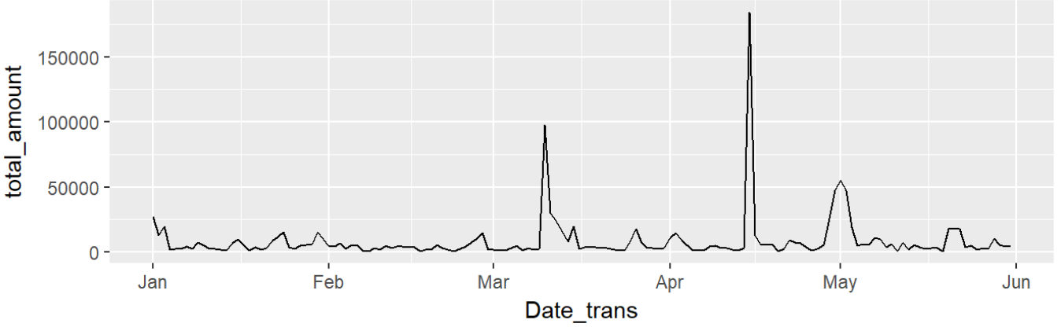
Daily Revenue Varies Based on Sales Promotion
Total purchase amount per day( daily revenue) increased significantly on particular days

Slide 5
Target the Potential Repurchase Customer to Increase Revenue
Targeting dormant one-time buyers/retain repeat customer will save marketing and sales cost as well as increase revenue
Acquire
New Customer
Reactivate
One-time Customer
Retain
Repeat Customer
Method: Customer acquisition by publishing ads on popular channels based on web analytics
Cons: Cost is high
Method: Create cluster to describe and target active customer
Cons: Limited by seasonality; Contributes revenue steadily
Target the most potential purchase customer with low cost

Slide 6


Project Goal: Target and Predict the Customer with High Repeated Purchase Rate to Increase Revenue
Key Focus
Data Source
Recognize the potential repeated purchase customer group
Predict the repurchase ones within target group
Daily transaction data from Jan’16 to Dec’16
Product and category data
Customer demographic data

Slide 7
Table
Of Content
01
Background and Key Question
02
Feature Exploratory
03
Prediction of Repurchase
04
Next Step

Slide 8
Task: Predict If Customer Will Purchase again between June and August
Target Defination: Classification Problem
Purchase Time>=1
Purchase?
Unknown Information
2016.01.01
2016.05.31
2016.08.31
2016.12.31

Slide 9

Understanding Interative Feature Engineering Process
Feature Construction & Selection
Feature Classification
Feature Initial Exploratory

Slide 10
Feature Classification
Feature Construction & Selection
Feature Classification
product profile, demographic profile and shipment profile
Character, categorical, numeric and date features
Feature Initial Exploratory

Slide 11
Feature Initial Exploratory
Feature Classification
Feature Construction & Selection
Feature Initial Exploratory
Product SKU1
Sales method
Shipment method
Accumulated Purchase Amount
Total purchase amount in 2016.1-2016.6
*Based on significance and correlation

Slide 12
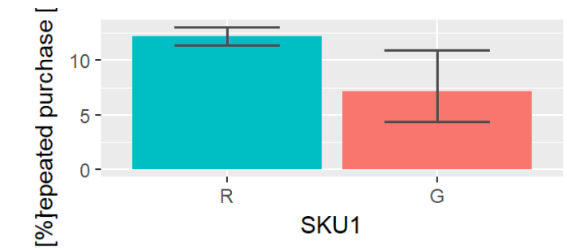
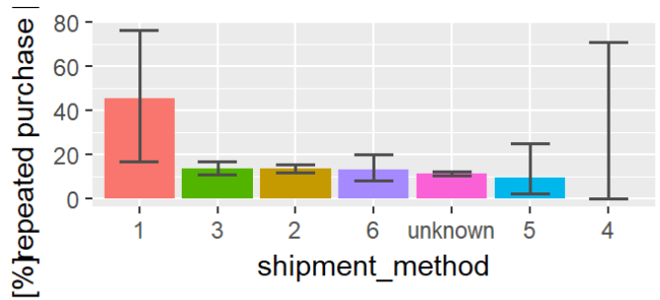
The Repurchase Rate Has Significant Difference Among Product SKU1&Shipment Method
Product Profile
SKU1
Shipment Profile
Shipment method
* The margin represents the confidence interval with 95% confidence level

Slide 13
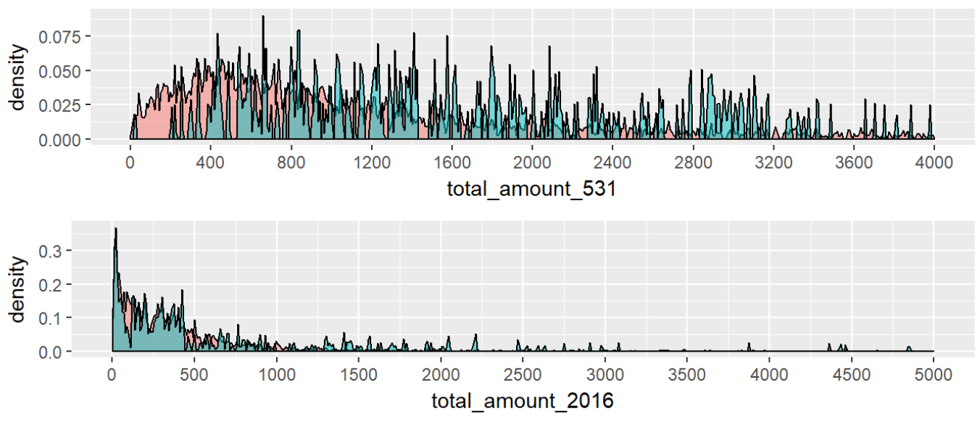

The Repurchase Rate Has Significant Difference Among Purchase Amount
User&Product Profile
Accumulated Total Purchase Amount
Total Purchase Amount in 2016.1-2016.5

Slide 14
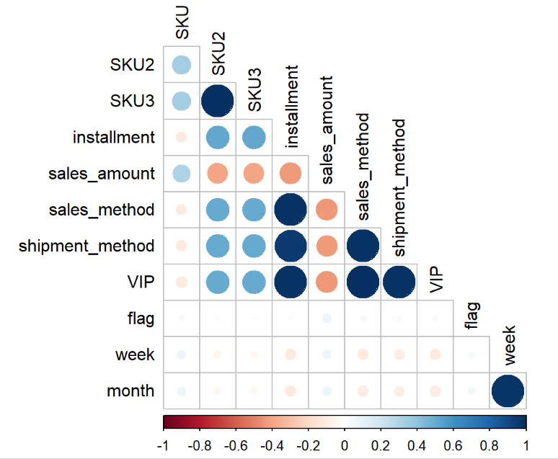
The Repurchase Rate and Sales Amount have weak positive correlation
Sales amount per product and flag have weak positive correlation
Other user features:
Some of them are highly correlated->
Remove them

Slide 15
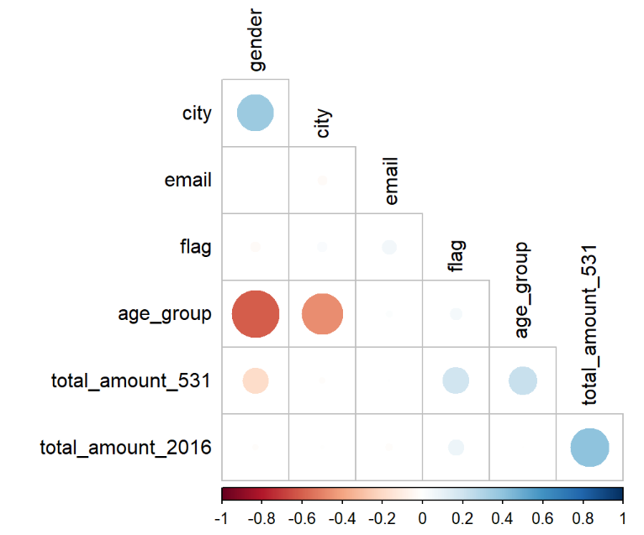
The Repurchase Rate and Accumulated Purchase Amount have strong positive correlation
Accumulated Total Purchase Amount has strong positive correlation with repeated purchase
Other user features:
Some of them are highly correlated->
Remove them

Slide 16
Feature Construction & Selection
Feature Classification
Feature Construction & Selection
Feature construction:
count/ratio by month
Aggregation
Recent activity
Feature Initial Exploratory

Slide 17


Feature Construction & Selection
Feature Filtering
Feature Wrapping
Method: Using information gain based on Decision Tree
Top 5 features:
Total purchase amount in Jan-May
Mean purchase amount per month
Standard Deviation of purchase amount per month
April Purchase Amount
Days between customer last purchase date and 2016.05.31
Method: Using Model-fitted feature importance: Xgboost weight
Top 5 features:
Accumulated Total Purchase Amount
Total purchase amount in Jan-May
Days between customer last purchase date and 2016.05.31
Standard Deviation of purchase amount per month
May Purchase Amount

Slide 18
Important Features to Classify Repeated Purchase Based on Model Performance
Feature Wrapping
Method: Using Model-fitted feature importance: Xgboost weight
Top 5 features:
Accumulated Total Purchase Amount
Total purchase amount in Jan-May
Days between customer last purchase date and 2016.05.31
Standard Deviation of purchase amount per month
May Purchase Amount
Final Selection:
Total 20 features

Slide 19
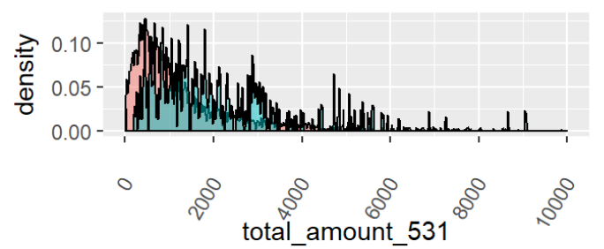
Customer with Higher Accumulated Purchase Amount has the Higher Chance to Purchase Again
Method: Using Model-fitted feature importance: Xgboost weight
Top 5 features:
Accumulated Total Purchase Amount
Total purchase amount in Jan-May
Days between customer last purchase date and 2016.05.31
Standard Deviation of purchase amount per month
May Purchase Amount

Slide 20
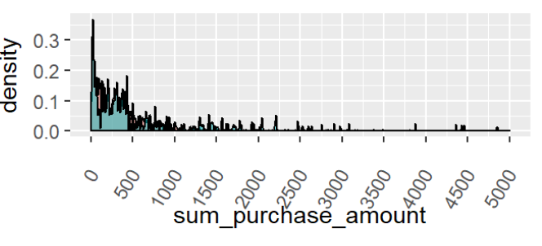
Customer with highest and lowest total purchase amount in 2016 has the higher chance to purchase again
Method: Using Model-fitted feature importance: Xgboost weight
Top 5 features:
Accumulated Total Purchase Amount
Total purchase amount in Jan-May
Days between customer last purchase date and 2016.05.31
Standard Deviation of purchase amount per month
May Purchase Amount

Slide 21
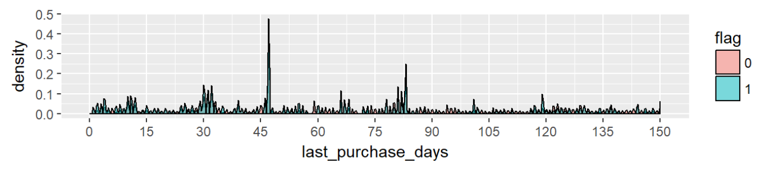
Customers who haven’t purchase for 7/12 weeksare most likely to purchase in next 2 months

Slide 22
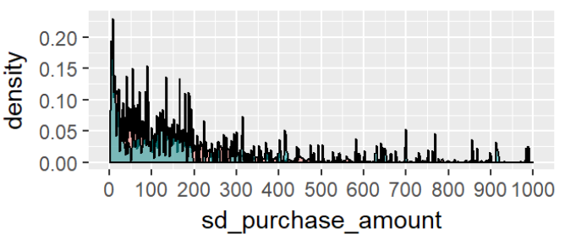
Customers whose purchase amount with lower variance have higher repeated purchase chance
Method: Using Model-fitted feature importance: Xgboost weight
Top 5 features:
Accumulated Total Purchase Amount
Total purchase amount in Jan-May
Days between customer last purchase date and 2016.05.31
Standard Deviation of purchase amount per month
May Purchase Amount

Slide 23
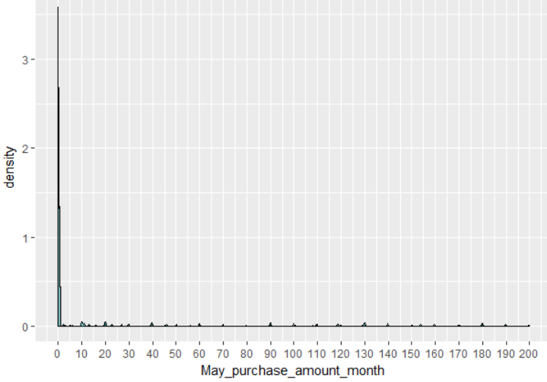
Customers with lowest purchase amount in May have higher chance to purchase in next 2 months
Method: Using Model-fitted feature importance: Xgboost weight
Top 5 features:
Accumulated Total Purchase Amount
Total purchase amount in Jan-May
Days between customer last purchase date and 2016.05.31
Standard Deviation of purchase amount per month
May Purchase Amount

Slide 24
Table
Of Content
01
Background and Key Question
02
Feature Engineering
03
Prediction of Repurchase
04
Next Step

Slide 25
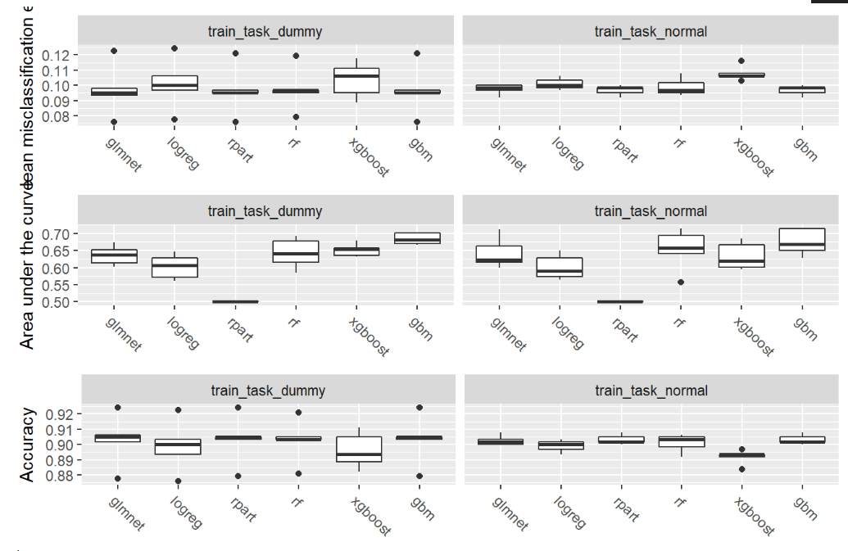
Model Selection And Comparation: GBM has a Higher Accuracy and AUC Through Cross-Validation
Models to Compare:
Tree-related
Glmnet
Logistic
Xgboost
Gbm
Dataset to Compare:
With/without Normalization
With/without Dummy variables
Metrics to compare model:
Accuracy
Area under Curve

Slide 26
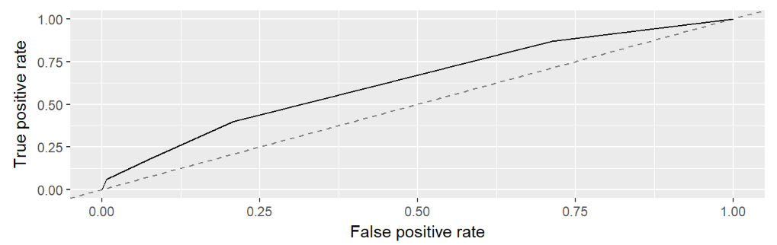
Model Selection And Comparation: GBM has a Better Performance after Tuning and Feature Selection
Final Model
Gradient Boosting with parameter tuning
Final Performance
Measure | Training | Testing
AUC* | 0.6959 | 0.6615
ACC | 0.9033 | 0.8901
AUC Interpretation: The expectation that a uniformly drawn random positive is ranked before a uniformly drawn random negative is 70%, which is much higher than 0.50

Slide 27
Prediction Performance and Business Impact
Impact
Revenue Increase=Acquire Revenue By Prediction
Acquire Revenue By Random Choose
89%
66%
Model Accuracy
Marketing cost saving
AUC

Slide 28
Table
Of Content
01
Background and Key Question
02
Feature Engineering
03
Prediction of Repurchase
04
Next Step

Slide 29

Next Step: Reactive Predicted Repeated Repurchase Customer with Limited Marketing Resource
Given the list of predicted repeated purchase customer
Launch different marketing campaign
Phone/e-mail reach out
Time limited sales
Member points reactivation

Slide 30
Thanks for The Attention
Retina Display
Any Question?

